Slide 1

Real-time Human Activity Recognition (HAR) System
DATA695
Research Internship in Data Science and Analytics
Hao Su An Yan

Slide 2

Introduction
Real-time human activity classification using deep learning techniques
Importance of accurate human activity recognition in various fields
Potential applications: surveillance systems, human-computer interaction, sports analysis
Real-time classification of complex human activities is challenging
Need for a robust and efficient solution for activity classification

Slide 3
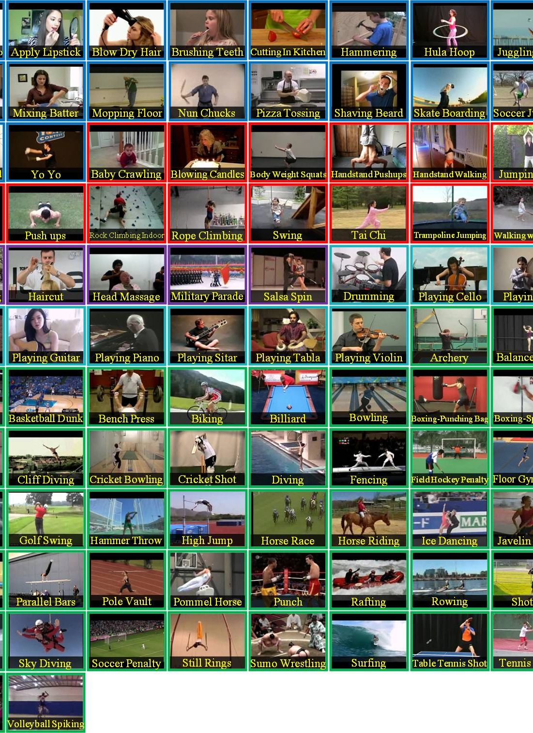
Datasource
Utilizing the UCF101 dataset for action recognition
13,320 labeled videos across 101 action categories
Grouped into Human-Object Interaction, Body-Motion Only, Human-Human Interaction, Playing Musical Instruments, and Sports

Slide 4

Methodology
Combination of Convolutional Neural Network (CNN) and Long Short-Term Memory (LSTM) Network
CNN for spatial feature extraction from video frames
LSTM networks for capturing temporal dependencies
Exploring the use of 3D Convolutional Neural Networks (Conv3D) to incorporate the time dimension
Deploying the trained model to a cloud service to implement an API for interaction with the model.

Slide 5

Tools
Python as the main programming language
TensorFlow for defining and training neural networks
OpenCV for real-time video processing and activity prediction
AWS or Google Cloud for scalability, ease of access, and integration with other applications or services

Slide 6
Analysis
Performance evaluation using precision, recall, and F1 score metrics
Utilizing confusion matrix to visualize model performance across activity classes
Frame-by-frame analysis to assess real-time activity recognition

Slide 7
References
UCF Center for Research in Computer Vision. (n.d.).
UCF101 - Action Recognition Data Set. UCF CENTER FOR REDEARCH IN COMPUTER VISION. https://www.crcv.ucf.edu/data/UCF101.php

